Slide 1
Biodiversity for the National Parks
By William Owen

Slide 2
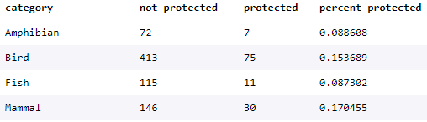

The data in species_info.csv
The data contains information on different species in US National Parks. It comes in the form of a table with the following categories: “category”, “scientific_name”, “common_names” and “conservation_status”.
Most of the species looked at do not require intervention (5363). 180 are of concern.
Of these, birds is the most common category to be protected (75). Mammals has the highest proportion of protected species (17%). Plants are the least protected (1%).

Slide 3
The significance calculations for endangered status between different categories of species
I performed a Chi-Squared Test for significance to determine whether certain categories of species are more likely to be endangered than others.
I found that although mammals have a higher percentage of protected species than birds, the difference is not statistically significant. Mammals are more likely to be protected than reptiles, fish and plants though.

Slide 4
A recommendation for conservationists concerned about endangered species, based on the significance calculations
The percentages to the right show that mammals have a higher percentage of protected species than do all other categories
However after performing a Chi-squared test for significance I found that the difference between mammal’s and birds and mammal’s and amphibian’s likelihood of falling into a protected category could be due to chance.
However the difference in percentage protected of mammals vs fish, reptiles and vascular and non-vascular plants was significant.
I therefore conclude that certain types of species are more likely to be endangered than others.

Slide 5
Sample size determination for the foot and mouth disease study
I used a sample size calculator with the following inputs:
Baseline conversion rate- the current rate that sheep have foot and mouth disease in Bryce is 15%
Statistical significance- 90% is the default level
Minimum detectable effect- the minimum level of improvement we would like to see over the baseline. Here it is 100 * [minimum level of detected reduction in foot and mouth disease] / [baseline conversion rate] = 33.3%
Therefore, the sample size needed is 870

Slide 6
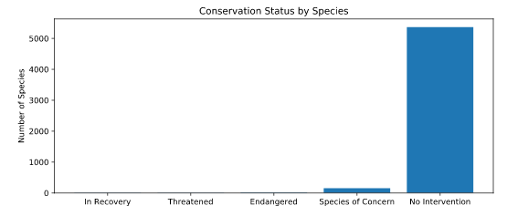
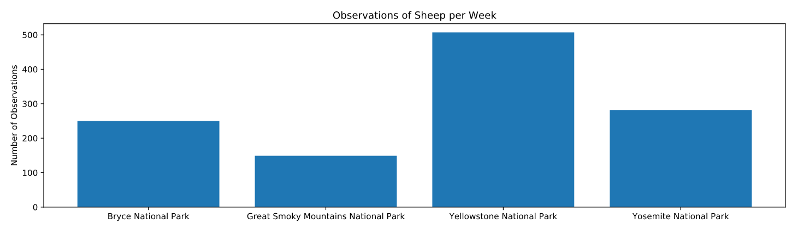
Graphs

